Slide 1
教師自我學習與自身職涯發展：科學知識是萬靈丹！？
數學生根計畫 期末討論
卓蘭國小 徐文忠
20180609

Slide 2
三項主題
學生碰到數學問題時求助行為？
在台灣，有哪些因素阻礙教師專業發展？
科學知識是萬靈丹嗎！？

Slide 3
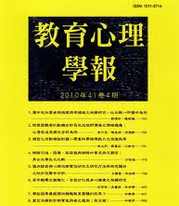
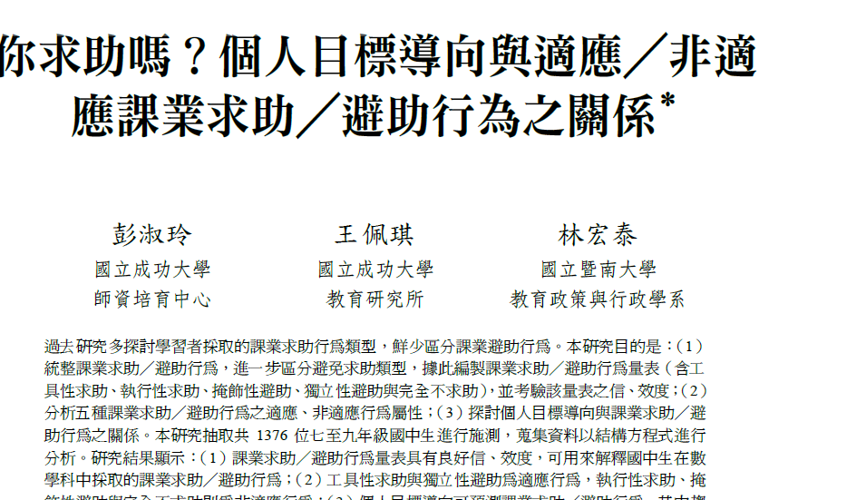

Slide 4
學生遇到問題時求助行為
求助
工具性求助：個體選擇向他人尋求解題的線索、提示等相關訊息。
執行性求助：學習者會直接向他人尋求問題答案，以快速地解決問題。
避助
掩飾性避助：個體遭遇學習困難時不願向他人求助，進而暗地或私下尋求解決方法，如偷偷抄襲同學或教科書答案、上網搜尋資料等行動來解決問題。
獨立性避助：個體遭遇學習困難時不願向他人求助，轉而自己產生或尋求各種可用的書面、文字或電腦資源，讓自己有更多線索或訊息來持續參與學習並解決問題。
完全不求助：個體遭遇學習困難時不願向他人求助，而是採取略過不理、猜測亂寫、隨便應付或拒絕參與等消極方式面對。
Notes:
統整過去課業求助／避助行為文獻，提出五種課業求助／避助行為。
【求助】
分工具性求助：意指個體選擇向他人尋求解題的線索、提示等相關訊息，以協助自己持續參與任務中並解決問題
執行性求助：說明學習者會直接向他人尋求問題答案，以快速順利地解決學習問題。
【避助】─避免求助
掩飾性避助：意指個體遭遇學習困難時不願向他人求助，進而暗地或私下尋求解決方法，如偷偷抄襲同學或教科書答案、上網搜尋資料等行動來解決問題。
獨立性避助：意指個體遭遇學習困難時不願向他人求助，轉而自己產生或尋求各種可用的書面、文字或電腦資源，以讓自己有更多線索或訊息來持續參與學習並解決問題
完全不求助：說明個體遭遇學習困難時不願向他人求助，而是採取略過不理、猜測亂寫、隨便應付或拒絕參與等消極方式面對。

Slide 5
學生求助行為調查
求助
工具性求助：____。
執行性求助： ____。
避助
掩飾性避助： ____。
獨立性避助： ____。
完全不求助： ____。
Notes:
統整過去課業求助／避助行為文獻，提出五種課業求助／避助行為。
【求助】
分工具性求助：意指個體選擇向他人尋求解題的線索、提示等相關訊息，以協助自己持續參與任務中並解決問題
執行性求助：說明學習者會直接向他人尋求問題答案，以快速順利地解決學習問題。
【避助】─避免求助
掩飾性避助：意指個體遭遇學習困難時不願向他人求助，進而暗地或私下尋求解決方法，如偷偷抄襲同學或教科書答案、上網搜尋資料等行動來解決問題。
獨立性避助：意指個體遭遇學習困難時不願向他人求助，轉而自己產生或尋求各種可用的書面、文字或電腦資源，以讓自己有更多線索或訊息來持續參與學習並解決問題
完全不求助：說明個體遭遇學習困難時不願向他人求助，而是採取略過不理、猜測亂寫、隨便應付或拒絕參與等消極方式面對。

Slide 6
學生求助行為調查
求助
工具性求助：5%。
執行性求助：30%。
避助
掩飾性避助： 45%。
獨立性避助： 2%。
完全不求助： 15%。
Notes:
統整過去課業求助／避助行為文獻，提出五種課業求助／避助行為。
【求助】
分工具性求助：意指個體選擇向他人尋求解題的線索、提示等相關訊息，以協助自己持續參與任務中並解決問題
執行性求助：說明學習者會直接向他人尋求問題答案，以快速順利地解決學習問題。
【避助】─避免求助
掩飾性避助：意指個體遭遇學習困難時不願向他人求助，進而暗地或私下尋求解決方法，如偷偷抄襲同學或教科書答案、上網搜尋資料等行動來解決問題。
獨立性避助：意指個體遭遇學習困難時不願向他人求助，轉而自己產生或尋求各種可用的書面、文字或電腦資源，以讓自己有更多線索或訊息來持續參與學習並解決問題
完全不求助：說明個體遭遇學習困難時不願向他人求助，而是採取略過不理、猜測亂寫、隨便應付或拒絕參與等消極方式面對。

Slide 7
Notes:
這篇的價值
Prior research indicates that many personal characteristics and task factors can affect the degree of teachers’ engagement in professional development. These personal factors include personal attitude and work expectation, while task factors contain learning systems, work conditions, job variety, and autonomy (Krauss & Guat, 2008; Kwakman, 2003).
Nevertheless, rather few studies examine the effects on teachers’ professional development by investigating the interplay of personal and contextual factors in a single model.

Slide 8
影響台灣教師專業發展的因素
Notes:
The concept of professional self-awareness in this study refers to
an individual’s awareness of his/her strengths and weaknesses on professional abilities in the workplace. It is also considered as the foundation to develop relevant job competencies (Cherniss & Goleman, 2006).
Professional self-awareness enables individuals to collect the information required to plan their career development (Holland, 1973). Teachers with greater professional self-awareness tend to be more aware of the knowledge and skills they need to strengthen to better respond to the dynamics of social, political, and cultural changes.
self-directed learning(SDL) SDL is conceptualized as
the degree to which the individual possesses the inclination to take responsibility for his/her own professional growth (Deng, 1995; Guglielmino, 1977).
SDL is often broadly conceived in terms of the amount of responsibility the learner takes for his/her own learning. This responsibility depends on an individual’s attitude, abilities, and personal traits (Fisher et al., 2001).
Professional self-awareness focuses more on an individual’s awareness of his/her strengths and weaknesses regarding professional capabilities. Professional self-awareness helps teachers understand society’s increasing expectations of their roles.
supportive organizational climate in this study refers to
teachers’ perceptions of a friendly, collaborative, encouraging, caring, or trustworthy school atmosphere that could create a nurturing learning environment (Shadur, Kienzle, & Rodwell, 1999; Wallach, 1983).
Teachers will be more willing to participate in professional development programs if they gain more support from the school administration for attending learning programs.

Slide 9
自我導向學習
自我導向學習(Self-Directed Learning)是指個人願意承擔自己的專業成長責任的程度。
這種責任感主要源自於個人的態度、能力和特質。
ㄧ個自我學習導向越高的人，參與專業發展的傾向越高。自我導向學習隱含了三個重要成分：自我管理、自我監控以及自我激勵。自我導向學習越高的人，自我學習的自律越高。
Notes:
-------------------------------------------------------------------------------------------------------------------------------------
SDL is conceptualized as the degree to which the individual possesses the inclination to take responsibility for his/her own professional growth (Deng, 1995; Guglielmino, 1977).
SDL is a well-developed concept
is an essential catalyst for individual career development
This responsibility depends on an individual’s attitude, abilities, and personal traits (Fisher et al., 2001).
Individuals who have greater SDL inclinations tend to be more involved in professional development (Kops, 1993, 1997).
SDL consists of three critical components: self-management, self-monitoring, and self-motivation.
individuals with greater SDL inclination tend to have a higher level of self-regulatory learning skills
SDLRS could be used as an assessment tool to help teachers understand their readiness level for SDL
------------------------------------------------------------------------------------------------------------------------------------
SDL is a well-developed concept
individuals with greater SDL inclination tend to have a higher level of self-regulatory learning skills. That is, they are able to collect relevant information and advice, effectively use a broad range of environmental resources, and perform in an active, responsible, and determined manner (Garrison, 1997; Tough, 1979).
For teachers who score low on SDL, HRD personnel need to provide them with developmental programs and learning resources to help them better improve their skills on self-management, selfmonitoring, and self-motivation that in turn facilitate the development of SDL (Garrison, 1997). However, the school might encourage teachers who score high on SDL to take on more responsibilities for coaching, initiating, and implementing learning projects (Ellinger, 2004).

Slide 10
自我覺察
自我覺察(self-awareness)指的是個體對於本身工作上的專業能力優缺點以及社會期待角色有所查覺。
自我覺察的能力會讓老師有效地善用資源與降低理想我(ideal self)與實際我(actual self)的差距。
Notes:
Professional self-awareness refer to an individual’s awareness of his/her strengths and weaknesses on professional abilities in the workplace. It
more relationship management and self-management skills for their own career development purposes
This enables teachers to utilize resources and to develop strategies to reduce the gaps between ideal and actual self (Boyatzis, 2002)
--------------------------------------------------------------------------------------------------------------------------------------------------------------
Professional self-awareness enables individuals to collect the information required to plan their career development (Holland, 1973). Teachers with greater professional self-awareness tend to be more aware of the knowledge and skills they need to strengthen to better respond to the dynamics of social, political, and cultural changes.
---------------------------------------------------------------------------------------------------------------------------------

Slide 11
支持性的組織氛圍
支持性的組織氛圍(supportive organizational climate)是指老師本身知覺到學校是否有友善、鼓勵、照顧與值得信賴的組織氛圍，支持老師進行學習活動。
組織氛圍是組織內成員所知覺到的組織特性，例如：政策、各項措施與作業程序。
Notes:
The supportive organizational climate in this study refers to teachers’ perceptions of a friendly, collaborative, encouraging, caring, or trustworthy school atmosphere that could create a nurturing learning environment (Shadur, Kienzle, & Rodwell, 1999; Wallach, 1983).
Organizational climate refers to employees’ perceptions of organizational characteristics, such as policies, practices, and procedures.
------------------------------------------------------------------------------------------------------------------------------------------------------------------------
Organizational climate can be assessed through nine categories in terms of
1-8 structure, responsibility, reward, risk, warmth, support, standards, conflict,
9 and identity that are revealed from organizational policies, practices, and procedures (Litwin & Stringer, 1968).

Slide 12
提出藥方
個人層次的個人覺察+組織層次的支持性氛圍=促進教師願意進行專業發展。
進行SDLR量表施測
低分組，協助找到自我進修動機。
高分組，啟動或規畫自我進修活動。

Slide 13
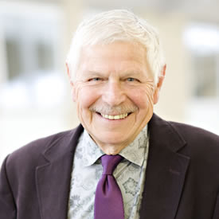
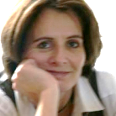

Slide 14
數學是科學
數學教學！？
Notes:
【參考文獻】
《Practice makes perfect? Skillful performances in veterinary work》(Clarke and Knights 2018)
‘We look for medicine to be an orderly field of knowledge and procedure but it is not. It is an imperfect science, and enterprise of constantly
changing, uncertain information, fallible individuals, and . . . lives on the line’ (Gawande, 2003: 4).
This view of medicine echoes a broader critique that ‘the “canonical model” of science has never been able to coincide with the practice itself’ (Collins and Evans, 2007: 1), so these struggles are both inevitable and inescapable because any pursuit of predictable certainty is inherently flawed (Miller, 2005).
研究建議：
our study shows how vetting is a work in progress, a craft involving ‘skilled interaction with the material world’ (Carmel, 2013: 734), where plans can, and must, be altered as ‘difficulties arise’. Rather than being interpreted as ‘a threat to the latent scientific character of medical practice’ or personal failure, this merely reflects how vetting is a form of ‘situated work’ (Berg, 1997: 1084). In crafting their practice, vets will inevitably experience episodes of ‘practical failure’, but if recognized as part and parcel of a contingent world, combined with theoretical techniques of training that cannot deliver on their promise of certainty and predictability (Berg, 1995, 1997), these need not automatically form the conditions for doubt and insecurities.
不要將獸醫視為是ㄧ種有次序性會可預測性的行業，並且接受它本身所具有的權變特性，將可以降低對自身的懷疑與不安全感。→發想：老師教數學是不是也是這樣？

Slide 15
認清事實
科學知識是建立在具有次序性(procedure)、因果性(causality)、可預測性(predictability)的基礎上。
實際情境，缺乏這樣的條件。
死守所謂的科學知識，是ㄧ種陷阱，ㄧ場幻夢。
Notes:
【參考文獻】
《Practice makes perfect? Skillful performances in veterinary work》(Clarke and Knights 2018)
‘We look for medicine to be an orderly field of knowledge and procedure but it is not. It is an imperfect science, and enterprise of constantly
changing, uncertain information, fallible individuals, and . . . lives on the line’ (Gawande, 2003: 4).
This view of medicine echoes a broader critique that ‘the “canonical model” of science has never been able to coincide with the practice itself’ (Collins and Evans, 2007: 1), so these struggles are both inevitable and inescapable because any pursuit of predictable certainty is inherently flawed (Miller, 2005).
研究建議：
our study shows how vetting is a work in progress, a craft involving ‘skilled interaction with the material world’ (Carmel, 2013: 734), where plans can, and must, be altered as ‘difficulties arise’. Rather than being interpreted as ‘a threat to the latent scientific character of medical practice’ or personal failure, this merely reflects how vetting is a form of ‘situated work’ (Berg, 1997: 1084). In crafting their practice, vets will inevitably experience episodes of ‘practical failure’, but if recognized as part and parcel of a contingent world, combined with theoretical techniques of training that cannot deliver on their promise of certainty and predictability (Berg, 1995, 1997), these need not automatically form the conditions for doubt and insecurities.
不要將獸醫視為是ㄧ種有次序性會可預測性的行業，並且接受它本身所具有的權變特性，將可以降低對自身的懷疑與不安全感。→發想：老師教數學是不是也是這樣？

Slide 16
提出藥方
外在的不確定性因素是不受控制的。
科學知識的追求，對專業而言，是有未逮之處的。
有些專業的確需要科學知識的輔佐。
懂得接受不完美的藝術
Notes:
(Mis)managing uncertainty: Our findings
Competence undone
Competence as accomplished performance
The art of imperfection

Slide 17
獸醫的情境與老師的教學現場
皆是人際相處的藝術與科學所結合而成的一門行業。
都需在法律、科學、魔法表演、及科學專業中進行不同的角色切換，但是評斷成果的方式卻是很單一。
獸醫
老師
寵物
飼主
學生
家長
Notes:
….
….
有著同樣的中介過程

Slide 18
科學實境 VS. 實際實境
獸醫的學校教育過程，是ㄧ種學術上具有確定性與因果性規則的訓練規則。
實務上，這樣有秩序性、規則性的法則，其實很少存在。反而他們所面對的是環境不確定性，但追求完美的解決方案，卻一直誘惑著他們。
當獸醫無法成功解決問題時，開始產生ㄧ種不切實際的理想性，這種理想性往往導致他們開始自我懷疑，甚至不安全感。
Notes:
many vets remain embedded in the disciplined ‘certainties’ and causal regularities within their training.
In practice this ordered world is rarely realized, and they are faced with indeterminacy where the ‘perfect’ solution eludes them.
Vets often turn these unrealistic ideals of expertise back in on themselves, thus generating doubt and insecurity for any failure in their practices.

Slide 19
當學生表現不如理想
老師自我學習

Slide 20
訪談稿
我不斷地需要證明、需要被獎勵、被肯定我在工作上表現得很不錯，我一直在尋求這方面的增強。(馬科獸醫，年資25年)
Notes:
I continuously need approval, need to be rewarded, being told I’m doing a good job. And, I seek reinforcement of that. (EP , 25yrs) EP=equine Parter

Slide 21
自我實現
不如
理想
自我學習
…...

Slide 22
不如
理想
自我學習
…...
自我懷疑

Slide 23
訪談稿
我從獸醫學校畢業後，預期所學的技能都可以進行有效地治療，但當實際治療方式沒有達到預期效果的時候，總是令人感到受傷(大型動物科獸醫，年資6年)。
Notes:
I came out from vet school anticipating that everything should always go right, and when things went wrong it was very traumatic. (LAV, 6yrs)

Slide 24
訪談稿
我們(獸醫)將自己視作是高度成功的人，我們喜歡成功，不喜歡犯錯。當事情的發展不是你所預期的，你就會將它當成是ㄧ種失敗(馬科獸醫，年資19年)。
Notes:
We view ourselves as high achievers, we like to be right, don’t we? I don’t like being wrong.
When it doesn’t go well, you see it as a mini failure, don’t you? (EV, 19yrs)

Slide 25
訪談稿
大學的學習是黑色或白色，可是真實的世界卻是灰色。你非常努力追求，到頭來終於了解它從來都不是黑色，也不是白色(小型動物科獸醫，年資16年)。
Notes:
Undergraduate learning is black and white. Come out to the real world and it’s just grey. You
struggle with things, and as you go through your career you realize that it never really was black
and white, just it was easier to digest if it was presented in that way. But, it’s a form of stress,
certainly for types we select that are slightly prone to perfectionism, it’s quite hard to deal with
sometimes. If things don’t fit into the way you’re told it’s going to happen, mentally ‘how do
you deal with that?’ (SAV, 16yrs)

Slide 26
失敗的必然性
質疑

Slide 27
自我實現
不如
理想
自我學習
…...
不完美的藝術
自我懷疑

Slide 28
訪談稿
有時經驗會告訴你，即使你做得很好，有些寵物會變得更好，但有些就是不會(小型動物科獸醫，年資26年)。
Notes:
Experience tells you that what you’re doing is fine, and some animals get better, and some
don’t, I guess. (SAP, 26yrs)

Slide 29
訪談稿
我不認為對專業的質疑會消失不見，我希望這種質疑永遠不會消失。因為你本來就不應該有錯誤的假設，認為質疑不應該存在(小型動物科獸醫，年資24年)。
Notes:
I don’t think doubt ever disappears. I hope doubt never disappears because you should never presume. (SAP, 24yrs)

Slide 30
建議與結論
當科學知識一直被神化，沒有人質疑科學知識在實務上的可運用性。但卻不斷的對自己產生質疑。
問題在於，在面對不確定因素下，自動化將科學知識與專業視為解藥，其實是讓自己受到進ㄧ步傷害。
察覺【科學知識的次序性、確定性與可預測性】─【實際情境的沒有次序性、沒有確定性、沒有可預測性】，其實是ㄧ種虛假的期待。才能夠從種種的誇張式的不當要求中獲得解脫。
Notes:
當科學知識一直被神化，沒有人質疑在實務上的可運用性，卻不斷的自我質疑，這篇研究提供情感上的支持，專業所面臨的問題不是說服聽眾的專業能力而已，更重要的是說服他們自己(獸醫)本身。
問題源於，自動化將科學知識與專業視為是面對顧客不切實際要求時解方，其實是讓自己受到傷害。
自身應該察覺有次序性、確定性與可預測性的科學知識不一定能解決他們所面對的沒有次序性、沒有可預測性的實際情境，其實是ㄧ種虛假的期待，他們才能夠從種種的誇張式的不當要求中獲得解脫。

Slide 31
